Slide 1

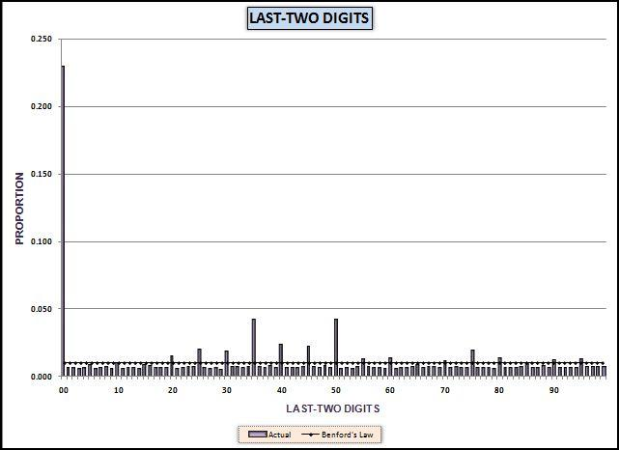
Chapter 8
Number duplication test
Last-two digits test
Completes the initial cycle of tests
Access and Excel
Prepared by:
Mark J. Nigrini
Copyright © 2012 by Mark J. Nigrini. All rights reserved.
Notes:
Pages 153 to 172.
Introduces the associated number duplication test and the last-two digits test. All tests can be done in either Access or Excel.

Slide 2
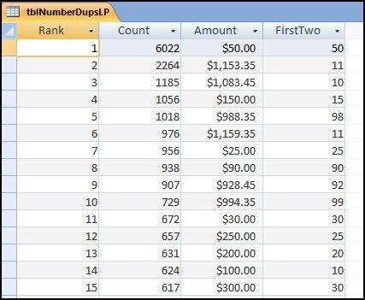
number duplication
Notes:
Pages 154 to 155.
Figure 8.5.
The test is essentially a numbers hit parade. These are the >=10 results for the invoices data.

Slide 3
number duplication
Link to first-order large positive spikes
Link to summation large positive spikes
Numbers below thresholds
Odd numbers that have occurred often
Relatively large counts
Numbers linked to inefficiencies
Notes:
Pages 154 to 155.
General discussion of the audit targets for the number duplication test.

Slide 4
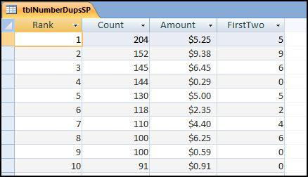
number duplication
Notes:
Page 161.
Figure 8.1.
The number duplication results for the small positive numbers. These show processing inefficiencies. See especially the invoices for $0.29.

Slide 5
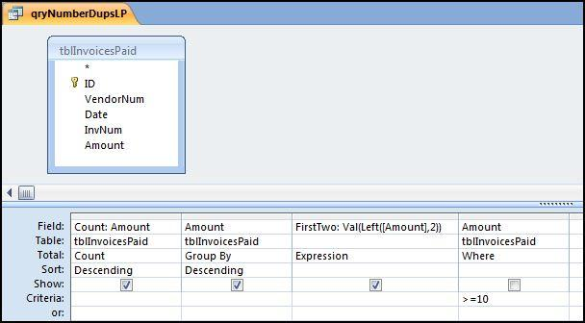
access steps
Notes:
Pages 155 to 164.
Figure 8.1.
The first number duplication query is shown in Figure 8.1. Change the query from the usual select query to a Make Table query by selecting Query Type→Make Table and naming the table tblNumberDupsLP. The LP at the end is there to indicate Large Positive.

Slide 6
access steps
Notes:
Pages 155 to 164.
Figure 8.5.
The Rank is added in Figure 8.4. To see the final result we have to look at the tblNumberDupsLP table in Datasheet view. The result is shown in Figure 8.5.
The number duplication results are shown in Figure 8.5. In the first row we can see that there were 6,022 invoices for exactly $50 each. This means that something cost $50 and the company purchased it six thousand times.

Slide 7
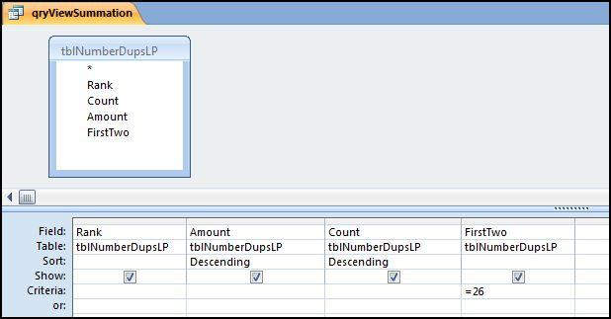
access drill down
Notes:
Pages 155 to 164.
Figure 8.7.
The last step in the number duplication test is to identify which amounts caused the spikes on the summation graph. The query to sort and to only extract the amounts associated with a specified first-two digit combination is shown in Figure 8.7.

Slide 8
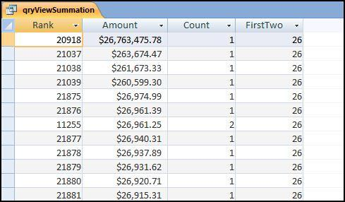
drill down result
Notes:
Pages 155 to 164.
Figure 8.8.
The last step in the number duplication test is to identify which amounts caused the spikes on the summation graph. The query to sort and to only extract the amounts associated with a specified first-two digit combination is shown in Figure 8.7.

Slide 9
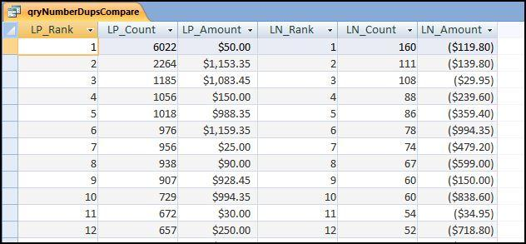
compare +ve and -ve
Notes:
Pages 155 to 164.
Figure 8.13.
The final numbers duplication test is a comparison. The idea came about during a forensic investigation of ticket refunds for an airline. The investigators took the position that since the most frequently flown segment for the airline was from Dallas to Chicago that we should expect the most frequently refunded segment to be "Dallas to Chicago." Similarly, if the best selling item for a fast food restaurant was its Double hamburger for $3.99 followed by its medium fries for $0.99, then we would expect most of the voids (sales amounts cancelled by the cashier) to be for $3.99 followed by $0.99.

Slide 10
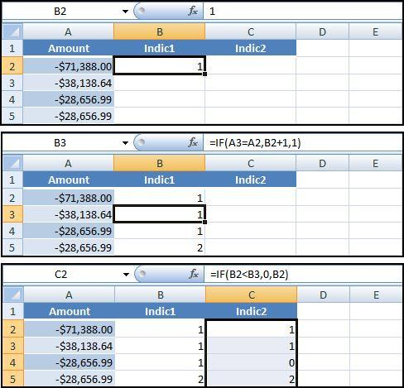
using excel
Notes:
Pages 164 to 167.
Figure 8.16.
The number duplications are calculated using indicator variables. The first indicator variable counts the number of equal amounts. The second indicator variable indicates when the highest count for a particular number has been reached. Both indicator variables use the IF function in Excel. The first "formula" is there just to start the sequence off at 1. The series of formulas is shown in Figure 8.16.

Slide 11
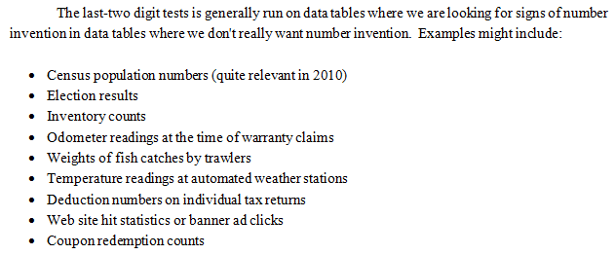
last-two digits test
Notes:
Pages 167 to 169.
General discussion of the audit targets for the number duplication test.

Slide 12
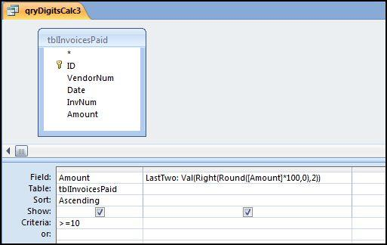
access steps
Notes:
Pages 169 to 171.
Figure 8.19.
The last-two digits formula is shown in Figure 8.19. The formula for the digits is more complex than usual and is shown below:
LastTwo: Val(Right(Round([Amount]*100,0),2))
In the formula the Val function changes the result to a numeric value, the Right function takes the rightmost two characters, and the Round function rounds the number to an integer value before any calculations are done. The comma two means that we want the rightmost two characters.
The rest of the steps use the same logic as the first-two digits test.

Slide 13
invoice data results
Notes:
Pages 170 to 171.
Figure 8.22.
The graph shows that about 23 percent of the amounts ended with 00. This means that those numbers were whole dollars with no cents. This is reasonably common for corporate accounts payable data. The most interesting result is the spikes at multiples of 5 with large spikes at 35, 40, 45, and 50. This is a very unusual result and we can also see this pattern from the numbers in the number duplication table in Figure 8.13.
Also, the last-two digits for the negative numbers also show a clustering at multiples of 5, but at higher numbers in the neighborhood of 80. The clustering around multiples of 5 is an anomaly as is the clustering around 40 for the positive numbers and 80 for the negative numbers.

Slide 14
summary
Num Dup test looks at the actual numbers
Separate tests for small and large +ve and -ve
Look for numbers associated with FTD spikes, control thresholds, and psychological thresholds.
Last-two digits test looks for number invention
Interesting results from invoices data
Num Dup & LTD tests can be run in Access or Excel
Notes:
Page 172, and a review of the main points.

